Slide 1
Fire Station Management System

Slide 2
Outline
Data Flow Diagram
Fish-Bone Diagram
Feasibility Analysis
Cost Analysis
Benefits

Slide 3
Subsystems
Employee Management System
Resources and Equipment Management System
Fire Response System
Post Fire System

Slide 4
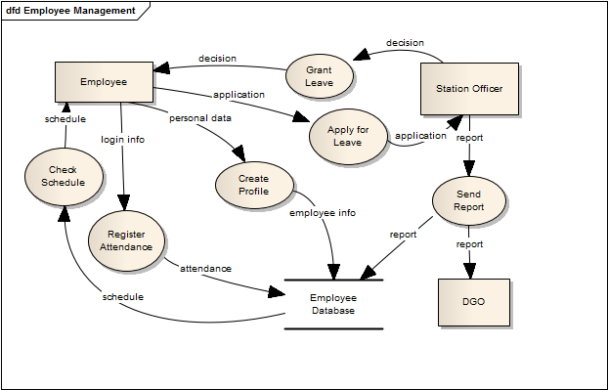
1. Employee Management
Data Flow Diagram:

Slide 5
1. Employee Management
Fish-Bone Diagram:
Worker
System
Lacks Technological Knowledge
Not User Friendly
Huge Work Load
Lengthy Manual Process
Server Down
Lack of Maintenance
Lack of Resource
Lack of Maintenance
Real Time Data Entry Required
Materials
Database
Data Operator

Slide 6
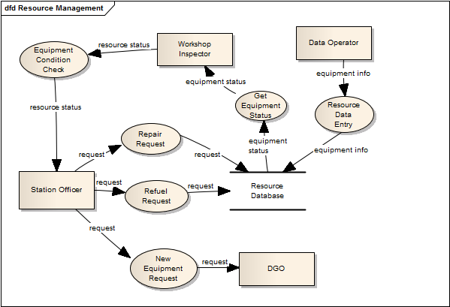
2. Resources and Equipment Management
Data Flow Diagram:

Slide 7
2. Resources and Equipment Management
Fish-Bone Diagram:
Database
Worker
Lack of Maintenance
Lack of Technical Knowledge
Less Efficient Management
Manual Data Entry
Lengthy Process
Not User Friendly
Method
System

Slide 8
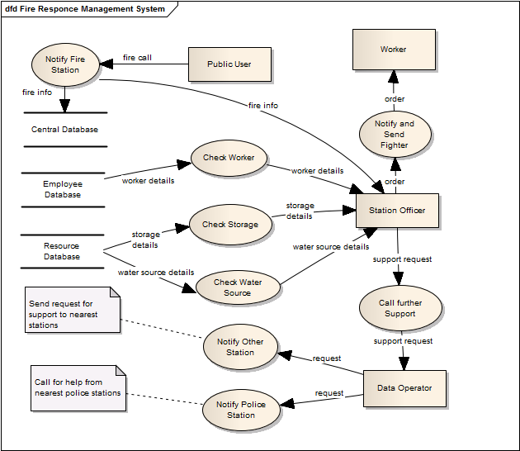
3. Fire Response Management
Data Flow
Diagram:

Slide 9
3. Fire Response Management
Fish Bone Diagram:
Public Users
Policies
Materials
Database
Unaware
Lack of Verification
Less Precaution
Server Down
Slow Fire Response
Not automated
Not Skilled
Lengthy
Lack of Knowledge of Resources
Procedure
Fire Fighter

Slide 10
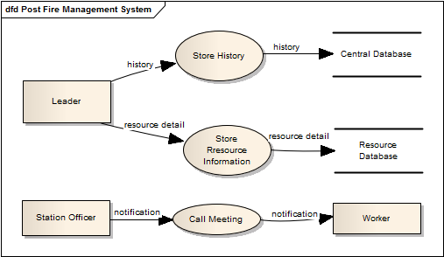
4. Post Fire Management
Data Flow Diagram:

Slide 11
4. Post Fire Management
Fish-Bone Diagram:
Database
Worker
Lack of Maintenance
Lack of Technical Knowledge
Inefficient Future Fire Response
Manual Data Entry
Lengthy Process
Not User Friendly
Method
System

Slide 12
Feasibility Analysis
Operational Feasibility
Cultural Feasibility
Technical Feasibility
Practical Implication

Slide 13
Operational Feasibility
User Friendly Fire Response Request System
Fire History for Analysis
Ever increasing database
infrastructures
water sources
police stations
hospitals

Slide 14
Operational Feasibility(contd.)
Complete worker database
Improved communication opportunity
Easier management of fire equipment

Slide 15
Cultural Feasibility
Quick fire response
Always prepared firefighters
Easier for leaders to manage team members
More automated, less paper based work flow

Slide 16
Cultural Feasibility(contd.)
More functional station management for station officer
Confidential reporting's security maintained by station officer and DGO
Efficient Information flow for employees

Slide 17
Technical Feasibility
Java for Smart Phone app
PHP for Server Side Scripting
JavaScript for Client Side Scripting
MySQL for Database
User Friendly designing will be dealt by Engineers

Slide 18
Practical Implication
System engineers will monitor any malfunction
Versioning of the system will be maintained

Slide 19
Cost Analysis: Development Costs
Sector | No of Employee | Time Period | Cost
System Analyst (35k/month) | 2 | 4 months | 280000
Programmer (40k/month) | 3 | 3 months | 360000
GUI Designer (40k/month) | 1 | 1 month | 40000
Database Specialist (40k/month) | 1 | 2 months | 80000
Total Development Costs: 10,30,000 BDT.

Slide 20
Cost Analysis: Annual Operating Costs
Sector | No of Employee | Cost
Data Operator (15k/month) | 1 | 180000
System Maintenance (25k/year) | -- | 25000
Domain (5k/year) | -- | 5000
Server Hosting (5k/year) | -- | 5000
Total Annual Costs: 2,15,000BDT

Slide 21
Tangible Benefits
Decrease fire response time
Manage equipment efficiently
Manage workers efficiently
Reduce paper works
Automate fire station

Slide 22
Intangible Benefits
Improve fire response system
Confidence increased after successful operation
Technical knowledge improved
Modern technology introduced
Reputation Increased
Better communication system between fire stations

Slide 23
Questions
??

Slide 24
Thanking You
Sadia Atique, 1005013
Tasmin Chowdhury, 1005025
Aman Ullah Aman, 1005026
Abdullah Al Fahim, 1005028
Hasanul Aziz, 1005030

